Slide 1


GPUs
More than gaming

Slide 2


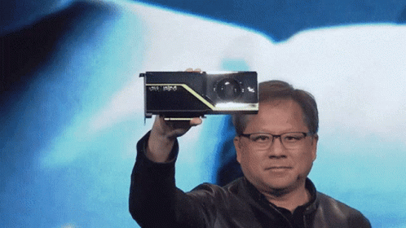
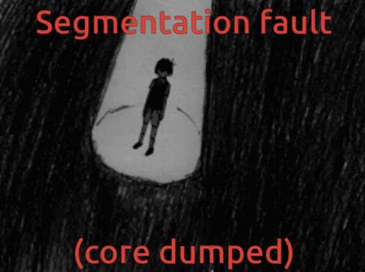

Agenda
Introduction
Architecture
Cuda
Practice

Slide 3
Intro
Why do these things even exist

Slide 4

Welcome to the 70’s
Not the 70’s we’re interested in

Slide 5

Welcome to the 70’s
Not the 70’s we’re interested in

Slide 6
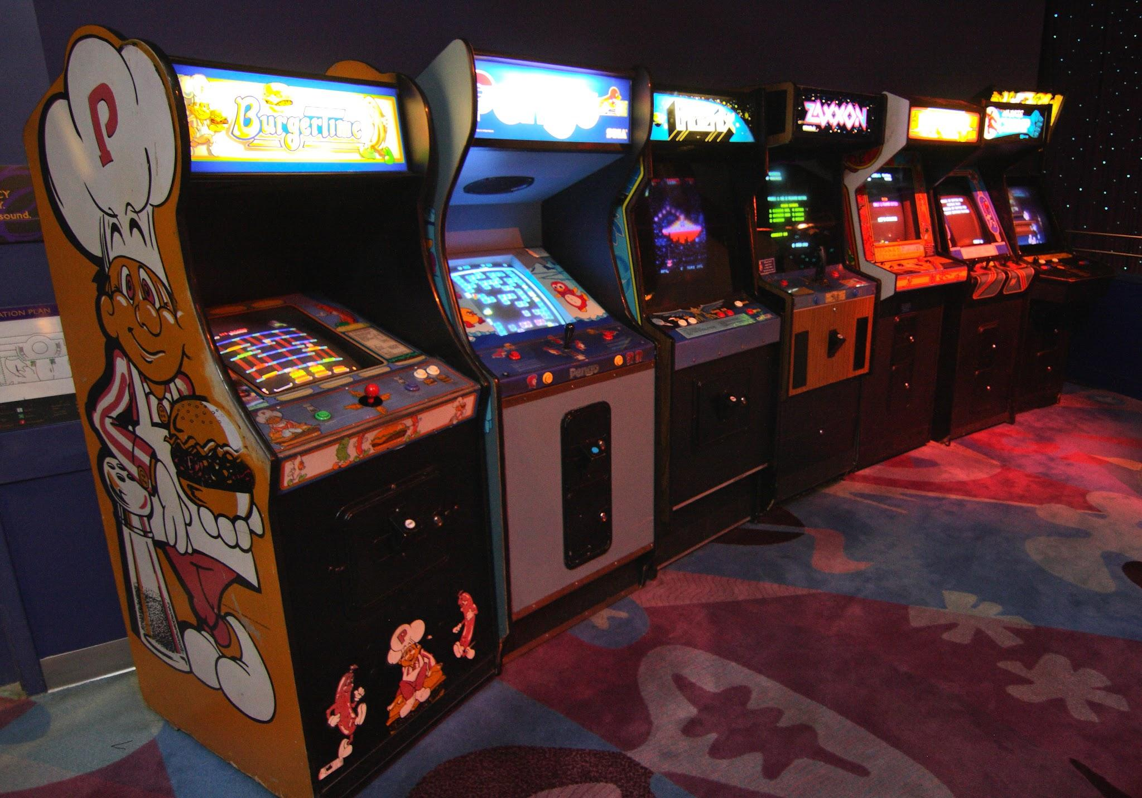
Welcome to the 70’s
Now we talking

Slide 7
In a nutshell? Gaming.
You may have heard that gaming is what drove the industry forward to create more powerful dedicated hardware

Slide 8
In a nutshell? Gaming.
You may have heard that gaming is what drove the industry forward to create more powerful dedicated hardware
And this is precisely right

Slide 9

The pre-GPU era
Early gpus were nothing more than super-specialized custom hardware to draw pixels on screen

Slide 10
The pre-GPU era
Early gpus were nothing more than super-specialized custom hardware to draw pixels on screen
This would free up the more slow cpu so that a not-so-powerful overall cpu was needed

Slide 11
The pre-GPU era
Early gpus were nothing more than super-specialized custom hardware to draw pixels on screen
This would free up the more slow cpu so that a not-so-powerful overall cpu was needed
Making the hardware for the cabinet way less expensive

Slide 12

Things escalated quickly
In the 80’s Gpus could perform way more tasks meeting the demand to display color

Slide 13

Things escalated quickly
In the 80’s Gpus could perform way more tasks meeting the demand to display color
In the 90’s 3d rendering was already possible by such devices

Slide 14

Moar than just Moar performance
I would like to briefly break down what a specialized chip would do to make something like crash bandicoot possible.

Slide 15

Triangles
I bet you already know that each 3d model is composed of triangles.

Slide 16
Triangles
I bet you already know that each 3d model is composed of triangles.
Such shapes hold (obviously) 3 vertices

Slide 17
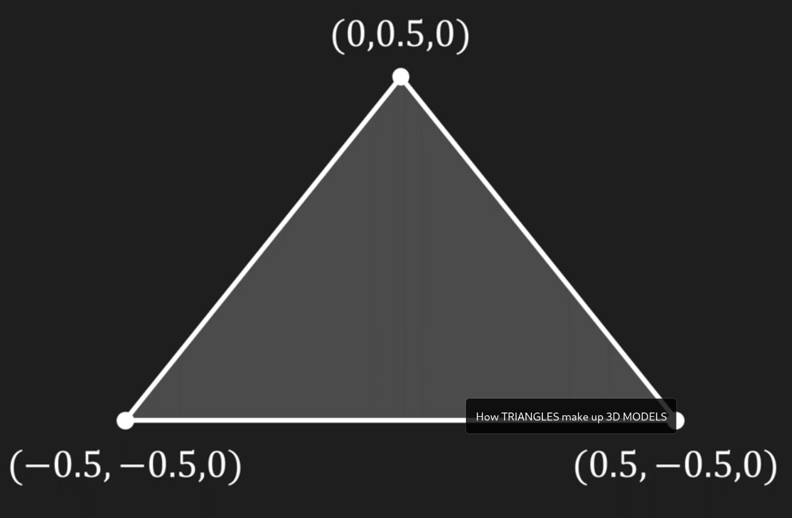
Coordinates and operations
Each vertice holds 3 coordinates in a 3d environment

Slide 18
Coordinates and operations
Each vertice holds 3 coordinates in a 3d environment
On each frame such triangles move, in particular

Slide 19
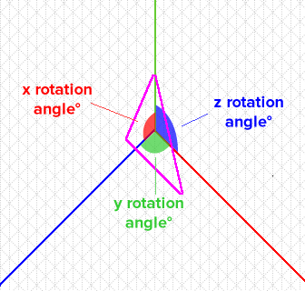
Coordinates and operations
They rotate.

Slide 20
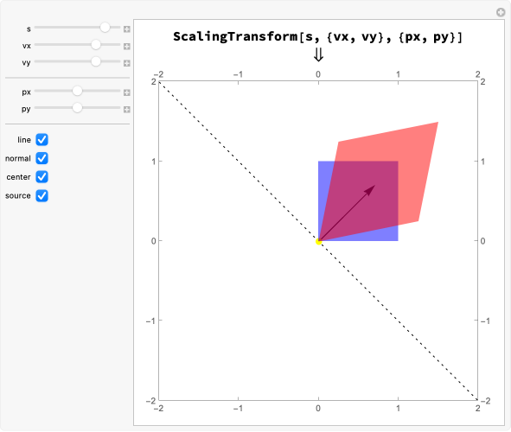
Coordinates and operations
They rotate
They shrink/enlarge (scale)

Slide 21
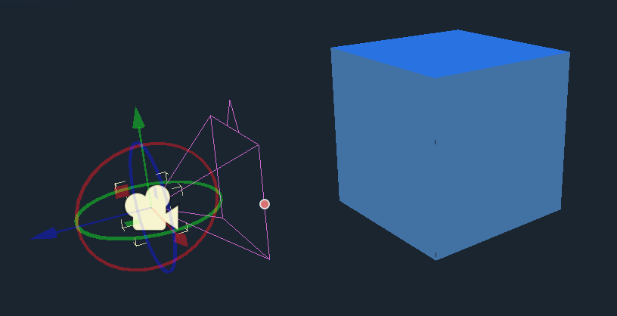
Coordinates and operations
They rotate
They shrink/enlarge (scale)
They get projected onto the screen

Slide 22
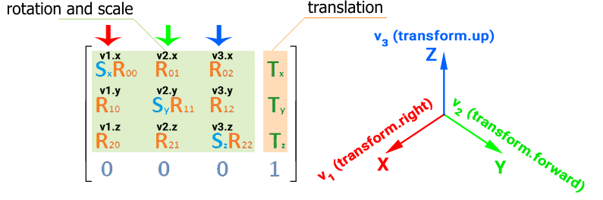
Coordinates and operations
All of this with the help of simple first year linear algebra maths: matrices

Slide 23
The need for speed™
Scenes in the 90’s typically contained about 40K+ triangles

Slide 24

The need for speed™
Scenes in the 90’s typically contained about 40K+ triangles
Each frame needed to be computed in about 33.33 ms

Slide 25
The keypoint
All of these operations can be done simultaneously
A chip to perform such task does not need to do everything a cpu can, just some multiplication/division for a huge number of objects in parallel

Slide 26
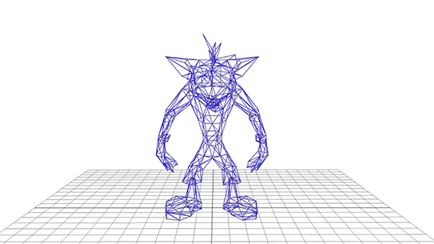
Modern Gpus
Thus “modern” gpus were born

Slide 27

In the meantime…

Slide 28
CPU History
How to get faster programs?

Slide 29

CPU History
How to get faster programs?
Just make the CPU faster.

Slide 30
CPU History
Does it actually work?

Slide 31
CPU History
Does it actually work?
Kinda

Slide 32
CPU History
Does it actually work?
Kinda
What are the limitations?

Slide 33
CPU History
Does it actually work?
Kinda
What are the limitations?
Physics

Slide 34
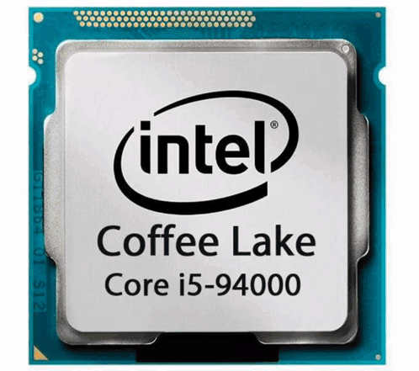
CPU History
More Frequency =

Slide 35
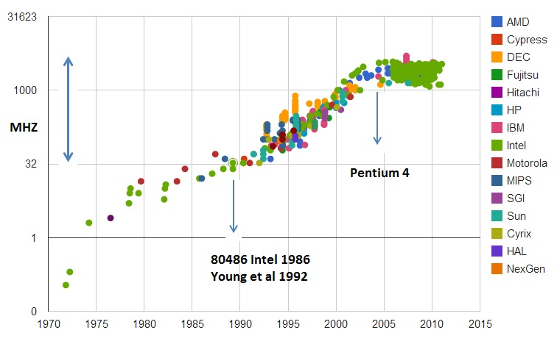
CPU History

Slide 36
CPU History
Maybe we need to find another way?

Slide 37
CPU History
Maybe we need to find another way?
We could go parallel

Slide 38
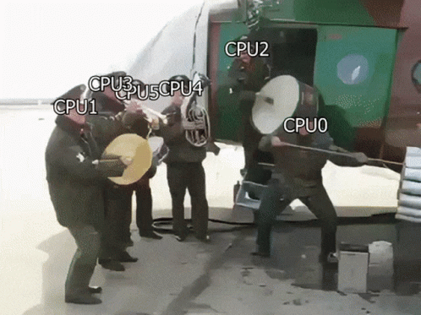
It’s Multicore Time
Average Multicore
Experience:

Slide 39
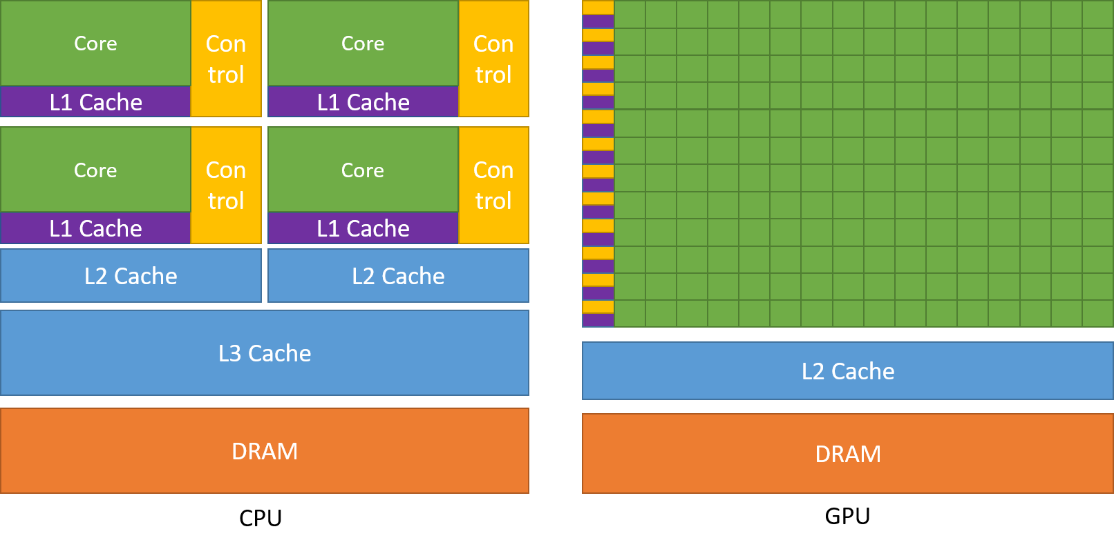
Multicore
Multicore CPU Architecture ->

Slide 40
Multicore
Not enough?

Slide 41
Multicore
Not enough?
We need more hardware

Slide 42
Multicore
Not enough?
We need more hardware
Maybe a dedicated one…

Slide 43
Multicore
Not enough?
We need more hardware
Maybe a dedicated one…
WAIT!! WE HAVE GPUS!!

Slide 44
CPU vs GPU

Slide 45
GPU
What is this?

Slide 46
GPU
What is this?
Obviously a Warp!

Slide 47
GPU
What is this?
Obviously a Warp!
A Warp is a collection of 32 cuda cores

Slide 48
GPU
What is this?
Obviously a Warp!
A Warp is a collection of 32 cuda cores
Every Warp shares the IP
(The Instruction Pointer
not the network address)

Slide 49
GPU
What is this?
Obviously a Warp!
A Warp is a collection of 32 cuda cores
Every Warp shares the IP
(The Instruction Pointer
not the network address)
Is this a problem?

Slide 50
GPU
What is this?
Obviously a Warp!
A Warp is a collection of 32 cuda cores
Every Warp shares the IP
(The Instruction Pointer
not the network address)
Is this a problem?
Yes, it can be

Slide 51

The Enemy

Slide 52
The Enemy
IF

Slide 53
Divergence
What happens if there is a branch in the execution flow?

Slide 54
Divergence
What happens if there is a branch in the execution flow?
We have an event called divergence

Slide 55
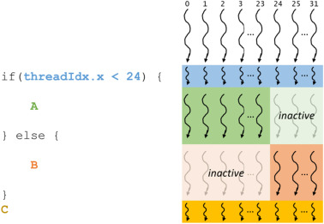
Divergence
What happens if there is a branch in the execution flow?
We have an event called divergence

Slide 56
Divergence
What happens if there is a branch in the execution flow?
We have an event called divergence
they are executed sequentially

Slide 57
Some clarifications…
In gpus:

Slide 58
Some clarifications…
In gpus:
Threads = Cores (Cuda cores)

Slide 59
Some clarifications…
In gpus:
Threads = Cores (Cuda cores)
Thread block = Streaming Multiprocessor

Slide 60
Some clarifications…
In gpus:
Threads = Cores (Cuda cores)
Thread block = Streaming Multiprocessor
Kernel Grid = The GPU

Slide 61
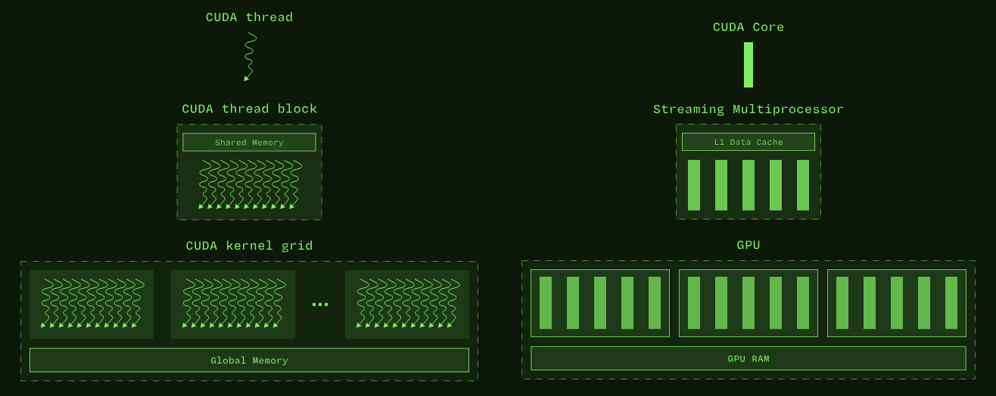
Little drawing on this

Slide 62
Scheduling
Now that we know this…
How we actually run threads?

Slide 63
Scheduling
Now that we know this…
How we actually run threads?
We can use…

Slide 64
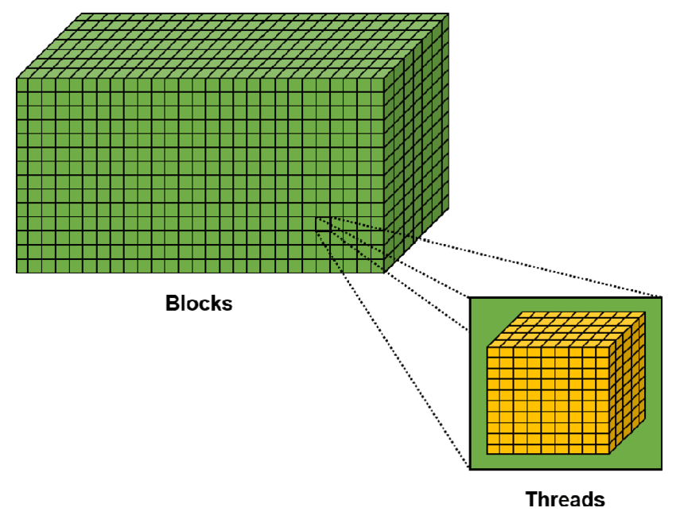
The Grid

Slide 65
The Grid
A grid is a 3D space composed by blocks

Slide 66
The Grid
A grid is a 3D space composed by blocks
A block is a 3D space made out of threads

Slide 67
The Grid
A grid is a 3D space composed by blocks
A block is a 3D space made out of threads
From an hardware POV, a block is made out of warps

Slide 68
Memory
Ok… Now we can run programs, but where do we store the data?

Slide 69
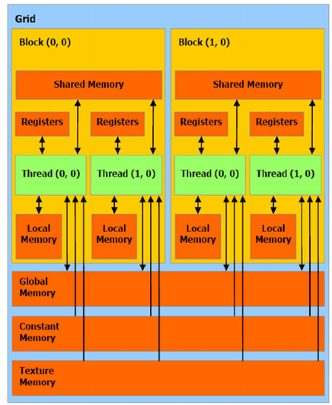
Memory
Ok… Now we can run programs, but where do we store the data?

Slide 70
Memory
We have a lot of memory types here:
Texture memory
Constant memory
Global memory
Shared memory
Local memory
Cache
Registers

Slide 71
Memory
Texture
It’s a global memory, and it’s used to store textures (it’s also optimized for them)

Slide 72
Memory
Texture
It’s a global memory, and it’s used to store textures (it’s also optimized for them)
Constant
It’s a read-only global memory

Slide 73
Memory
Texture
It’s a global memory, and it’s used to store textures (it’s also optimized for them)
Constant
It’s a read-only global memory
Global
It’s a global memory similar to our standard heap

Slide 74
Memory
Texture
It’s a global memory, and it’s used to store textures (it’s also optimized for them)
Constant
It’s a read-only global memory
Global
It’s a global memory similar to our standard heap
Shared
It’s a memory shared between threads inside a block

Slide 75
Memory
Texture
It’s a global memory, and it’s used to store textures (it’s also optimized for them)
Constant
It’s a read-only global memory
Global
It’s a global memory similar to our standard heap
Shared
It’s a memory shared between threads inside a block
Local
It’s a thread local memory used like the traditional stack

Slide 76
Texture memory
What does it mean that this memory is “optimized for textures”?

Slide 77
Texture memory
What does it mean that this memory is “optimized for textures”?
First, some debunking, texture memory as “dedicated memory for textures” does not exist

Slide 78
Texture memory
What does it mean that this memory is “optimized for textures”?
First, some debunking, texture memory as “dedicated memory for textures” does not exist
We refer to texture memory as global memory for which there’s a dedicated cache that uses a spatial locality policy, which in case of texture workloads (not only), can really speed up reads.

Slide 79
Texture memory
What does it mean that this memory is “optimized for textures”?
First, some debunking, texture memory as “dedicated memory for textures” does not exist
We refer to texture memory as global memory for which there’s a dedicated cache that uses a spatial locality policy, which in case of texture workloads (not only), can really speed up reads.
Such cache is READ ONLY, so not every application will benefit, also has some hardware enhancements to deal with on-fly decompression etc…

Slide 80
Constant memory
Constant memory follows the same fate, in a sense that it does not really exist and is part of global memory…

Slide 81
Constant memory
Constant memory follows the same fate, in a sense that it does not really exist and is part of global memory…
but

Slide 82
Constant memory
Constant memory follows the same fate, in a sense that it does not really exist and is part of global memory…
but
It is cached in special 64K read only block

Slide 83
Constant memory
Constant memory follows the same fate, in a sense that it does not really exist and is part of global memory…
but
It is cached in special 64K read only block
It supports broadcasting of a single value within all the elements of a warp, providing near-register-speed access when all threads access the same element at the same time

Slide 84
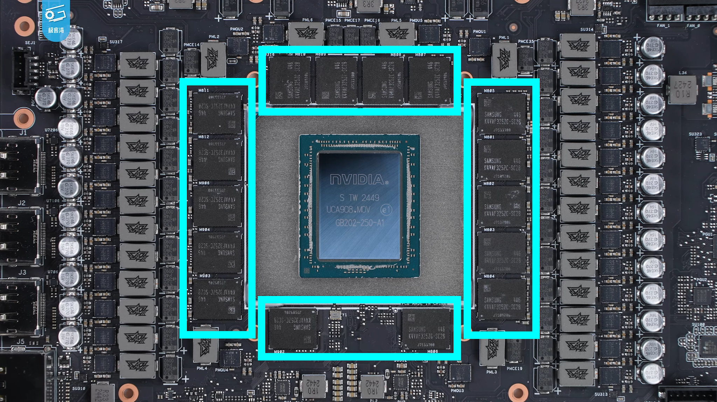
Global memory
VRAM.

Slide 85
Shared memory
Blazingly fast on-chip memory.

Slide 86
Shared memory
Blazingly fast on-chip memory.
According to NVIDIA, memory latency can get down to 100x smaller *compared to uncached Global memory

Slide 87
Shared memory
Blazingly fast on-chip memory.
According to NVIDIA, memory latency can get down to 100x smaller *compared to uncached Global memory
Threads within a thread block can access shared memory loaded in from other threads, giving the user the ability to create and manage caches

Slide 88
Local memory
Threads can have their own local memory, isolated from other threads

Slide 89
Local memory
Threads can have their own local memory, isolated from other threads
Such memory isn’t particularly fast… (similar speeds to the global memory)

Slide 90
Memory
Are we done with memories?

Slide 91
Memory
Are we done with memories?
Well…

Slide 92
Zero-Copy Memory
What is this?

Slide 93
Zero-Copy Memory
What is this?
This is a page-locked memory
It’s pinned in memory, so it cannot be swapped

Slide 94
Zero-Copy Memory
What is this?
This is a page-locked memory
It’s pinned in memory, so it cannot be swapped
The GPU access this memory directly into the CPU’s RAM

Slide 95
Memory
ARE WE DONE NOW??

Slide 96

Memory
ARE WE DONE NOW??

Slide 97
Unified Memory
Also known as Managed Memory

Slide 98
Unified Memory
Also known as Managed Memory
This maps memory in both CPU and GPU memory

Slide 99
Unified Memory
Also known as Managed Memory
This maps memory in both CPU and GPU memory
On page fault copies automatically the memory

Slide 100
Unified Memory
Also known as Managed Memory
This maps memory in both CPU and GPU memory
On page fault copies automatically the memory
Cons: initial fault latency

Slide 101
Memories
Now We’re done FR

Slide 102

Memories
Now We’re done FR

Slide 103
Atomic
What if we want to do something simple like
var += result
with var as something shared

Slide 104

Atomic
What if we want to do something simple like
var += result
var ->

Slide 105

Atomic
What if we want to do something simple like
var += result
We can go Atomic!

Slide 106
Atomic
What if we want to do something simple like
var += result
We can go Atomic!
We have the standard atomic operations

Slide 107
Atomic
What if we want to do something simple like
var += result
We can go Atomic!
We have the standard atomic operations
Bitwise
Arithmetical
Compares
And more…

Slide 108


The End
Now Practice!
Me ssh-ing into toms docker and performing sudo rm -rf /:

